Slide 1
Barriers to Communication

Slide 2
Introduction
Effective communication occurs if the receiver understands the idea that the sender intended to transmit
The process of communication may be blocked due to many reasons
Communication barriers are obstacles in the process of communication that hinder smooth progression of ideas
Many socio-psychologists believe that there is 50-70% loss of meaning while conveying the message from a sender to a receiver

Slide 3
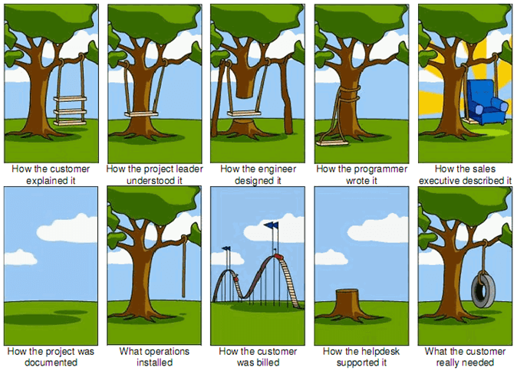

Slide 4
Types
Sender-oriented barriers
Receiver-oriented barriers

Slide 5
SoB Characteristics CAUSES
Groping for the right message
Superior attitude
Lack of collaborative effort
Mental block
Lack of language skills
Bypassing
Frame of reference
Distractions
Over/under communication
Loss in impact
Lack of preparation
Feeling of ‘I’ attitude
Preconceived ideas and notions
Unfamiliarity with the language
Inability to read intent behind the words
Difference in perceptual field
Physical and mental
Lack of structure
Incomplete information

Slide 6
Overcoming SoB
Structure and restructure your thoughts
View all receivers at the same level - Shift emphasis to ‘you’
Assess the situation and the people in a proper manner
Practice, practice and practice
Read the message in its entirety-the words and the intent
Listen to the receiver
Concentrate on the situation
Access audience needs
Think and structure your points

Slide 7
RoB CHARACTERISTICS CAUSES
Mental turbulence
Ineffective grasp of the message
Partial grasp of the message
Difference in reception and comprehension
Distancing from the speaker
Misunderstandings
Biased Listening
Lack of provision of correct feedback
Confusion or disturbance
Lack of knowledge
Lack of interest
Preoccupation
Evaluative/judgemental
Difference in understanding the intent of the sender
Preconceived ideas and notions
Arguments and discussions

Slide 8
Overcoming RoB
Check and confirm the reliability and validity of the utterance
Build an information base
Develop interest by looking for linkages
Check and recheck with sender the intent of the message
Delay evaluation
Sort out differences between the sender and the self
Concentrate on the message
Listen carefully before presenting your point of view

Slide 9
Different barriers
The Noise Barrier
The problem of Media selection
The Feedback Problem
The problems of Language and Articulation
Physical barriers
Mental Barriers
Personal Barriers
Interpersonal Barriers
Cultural Barriers
Information overload

Slide 10
The Noise barrier
Noise is any random or persistent disturbance that obscures the quality of the transmitted message
Any interference that takes place between the sender and the receiver
Example: During a conversation if anyone is distracted by the newspapers on the desk or calendars on the wall or the conversation going on in adjacent room
The quality of effective communication is affected by this noise
Discovering the source of noise is important to overcome this barrier

Slide 11
Types
Psychological: Mental preoccupation/ego/anxiety/tiredness/preconceived ideas and notions
Physical: Disturbances and distractions in the environment

Slide 12
The problem of media selection
In any given situation, the transmission mode for communication must be selected
Media selection can be based on personal choice or organizational norms
The media becomes a barrier to communication when the wrong channel is selected
If an employee is asked to leave an organization by email rather than face to face interaction, the communication is insensitive
Recent Mass tech layoffs by the Microsoft and other companies
sudden job cuts and inconvenience of the workers

Slide 13
The Feedback Problem
Feedback is reaction to the message of sender
It includes verbal and non-verbal responses
Without feedback the sender of the message can’t know whether the recipient has received the entire message and comprehended its content
It regulates both the transmission and reception of the message
Two sided expression, when combined with mutual feedback, becomes a dialogue
There is no feedback in one way communication
If the feedback provided to the sender is inaccurate, it can create a barrier to the communication process

Slide 14
Manifestation of feedback
Evaluative: Judges the worthiness of the other person
Interpretive: Paraphrases the other person’s statement
Supporting: Motivates the other person
Probing: Seeks to clarify and gain additional information
Understanding: Seeks to decipher the other person’s meaning of the message

Slide 15
The problems of language & articulation
The sender must ensure that the receiver understands the symbols and signs being used
Language and communication dynamics have become the driving force in international business operations in recent times
Three potential language barriers
Use of improper words
Use of jargons
Ambiguity

Slide 16
Improper words
Improperly used words create the wrong impression
Most words have more than one meaning in different cultural contexts
Poor communication happens when the sender transmits the message without knowing the receiver’s background, experiences and attitude
Vague and unclear message is a barrier to effective communication
Example: Please submit the file by tomorrow morning.
This message is very unclear. What kind of file is not mentioned over here. It will rather confuse the receiver

Slide 17
Use of jargon
It includes technical language and acronyms as well as recognized words with specialized meanings
Use of jargon can improve communication when both the sender and the receiver understand the specialized language
If that is not the case , it can be a serious communication barrier
Example: A student from civil engineering branch may not understand the jargon used in the medical field

Slide 18
Ambiguity
Ambiguous words or terms confuse the receiver and that leads to misunderstanding
Words that have several possible meanings are difficult to comprehend
Example:
If a co-worker says, Would you like to check the figures again?
It may mean that the co-worker is telling you to double-check the figures
You may think that the co-worker is merely asking if you want to do this.
Relevant details must be submitted for preparation of orders by Friday
Are details required by Friday?
Is the order to be prepared by Friday?

Slide 19
Physical barriers
It includes large working areas that are physically separated from others
In the workplace it includes closed office doors, barrier screens, separate areas for people of different statuses and so on
Distracting body movement can also create physical barriers
Background noise can affect the whole process of communication
Negative environment which is not conducive to healthy talks
Uncomfortable seating arrangements
Physical discomfort caused by uncomfortable temperature

Slide 20
Mental barriers
The perceptual process determines what messages we select as well as how the selected information is organized and interpreted
Significant chance of noise exists if the sender’s and receiver’s perceptions are not aligned
Noise can exist in the mind of the speaker or the recipient
It can be due to many factors: emotional attitude of the speaker or the receiver, faulty assumptions, stereotyping, fixed beliefs and closed mindset
The sender or receiver’s sense of superiority and egocentricity can lead to poor communication
Preconceived attitudes also affect our ability to listen

Slide 21
Personal Barriers
Chief barrier to open and free communication is the emotional barrier
It comprises fear, mistrust and suspicion
Many people hold back from communicating their thoughts and feelings to others due to emotional mistrust
Excessive fear of what others might think of us can stunt our development as effective communicators

Slide 22
Interpersonal barriers
The aim of interpersonal contact is closeness. That happens when there is a high level of honesty and acceptance of yourself and others
Nowadays technology also plays pivotal role in interpersonal communication
There are levels at which people distance themselves from one another
Withdrawal: Interpersonal contact is shunned when an individual refuses to be in touch
Rituals: Interpersonal contact is perceived to be mere formality, devoid of genuine interaction

Slide 23
Continued……
Pastimes: Interpersonal relationships are perceived as social but superficial activities to be indulged in when one is free
Working: Interpersonal activities are confined to discussions at work, but no further
Games: This is where interpersonal activities are considered to be subtle, manipulative interactions that are about winning and losing

Slide 24
Cultural barriers
Intercultural communication has become more common in the present scenario than ever before
The differences in cultural values cause socio-cultural barriers
When we interact with a cross cultural group and wish to associate with it, we need to adopt the behaviour patterns of the group. The group reverts back by showing recognition and approval
When you are not able to adjust to the new setting, cultural barriers crop in
Cultural barriers prevent people from different cultures from effectively communicating and working with each other. Cultural barriers can be caused by differences in languages, beliefs, or values.
Formal workspace vs Informal workspace
Sensitive TL vs Insensitive TL
US vs THEM

Slide 25
Information overload
It occurs when the amount of information received exceeds the person’s capacity to process it
It is a significant obstacle in the path of effective and smooth communication
When people are bogged down with too much information they are likely to make errors – inefficient – stress and anxiety
It can be overcome either by increasing the capacity of processing information or by reducing the amount of information that is being processed

Slide 26
Continued…….
If the message contains information that is new to the receiver, including processes or concepts that are not familiar, then the chances of overload increase greatly
The sender should break up the message into more palatable or digestible bits and reduce the amount of information that has to be absorbed at any one time

Slide 27
Chronomatic Barriers
Related to time
Individuals operate on different temporal wavelengths
Cultural background, work habits, personal preference
Rigid – pre-set schedule vs flexible
Attention avalanche – hasty words, incomplete thoughts
Misalignment of time zones
Digital distractions
‘always on’ fallacy

Slide 28
Organisational Barriers
Hierarchical Structure
breakdowns can occur due to rigid hierarchies
Information may not flow freely between different levels of the organization
Lack of Clarity in Policies
Unclear communication policies and guidelines can lead to confusion
Employees may be unsure about the appropriate channels for communication

Slide 29
Ineffective Collaboration
Hinders teamwork and collaboration
Misunderstandings
Leads to confusion, errors, and conflict
Reduced Productivity
Delays in information transfer impact efficiency

Slide 30
Overcoming Communication Barriers
Promote Open Communication
Provide Training
Use Multiple Channels
Cultural Sensitivity Training
Regular Feedback Mechanisms

Slide 31
Read and think!
https://www.thedailybeast.com/bad-writing-costs-businesses-billions?ref=scroll
https://www.theglobeandmail.com/report-on-business/comma-quirk-irks-rogers/article1101686/
Who is communicating to whom about what, how, and why? What was the goal of the communication in each case?
Identify the problem
Can you suggest some possible solutions?

Slide 32
THANK YOU

